Slide 1
Knowledge In The World Classes of Users

Slide 2
Quick quiz
Quick! Draw a pheasant!

Slide 3
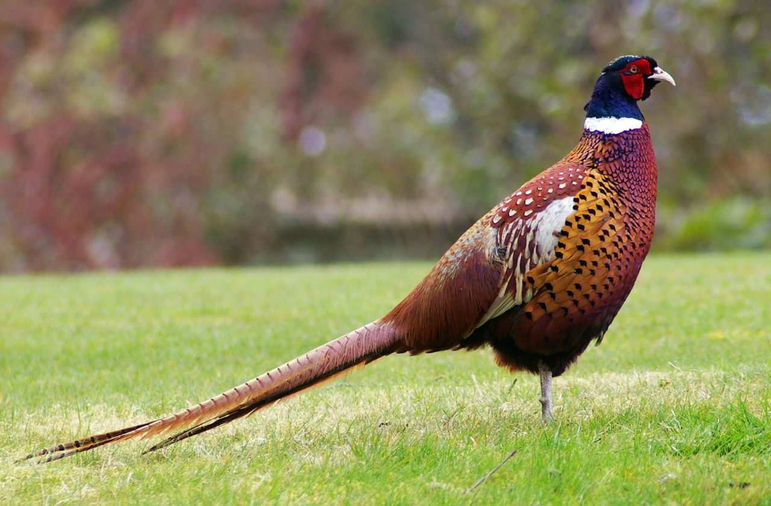
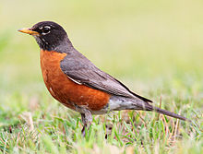
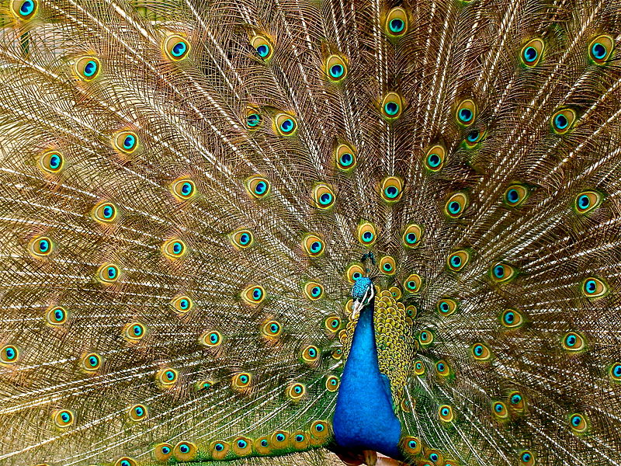
Which of these is a pheasant?
Thanks to Wikipedia for all images

Slide 4
Which of these is a pheasant?
Thanks to Wikipedia for all images

Slide 5
Overview
Knowledge in the Head vs. Knowledge in the World
Why Smartphones are Awesome
Categories of Users

Slide 6
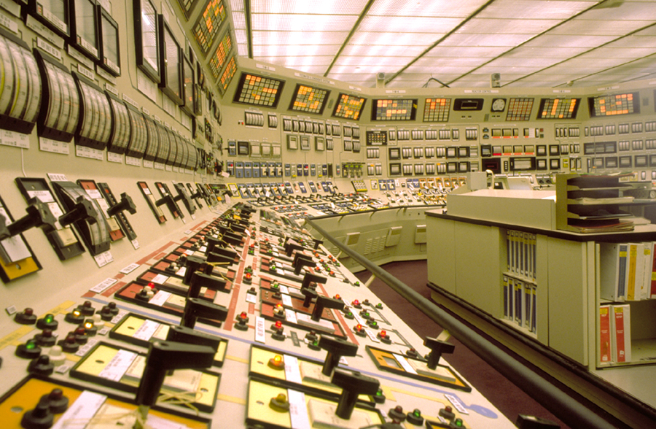
Knowledge in the World
Visible/audible/tactile
Don't have to memorize
Thanks to: http://web.ornl.gov/info/ornlreview/v38_1_05/images/a11_controls_full.jpg

Slide 7
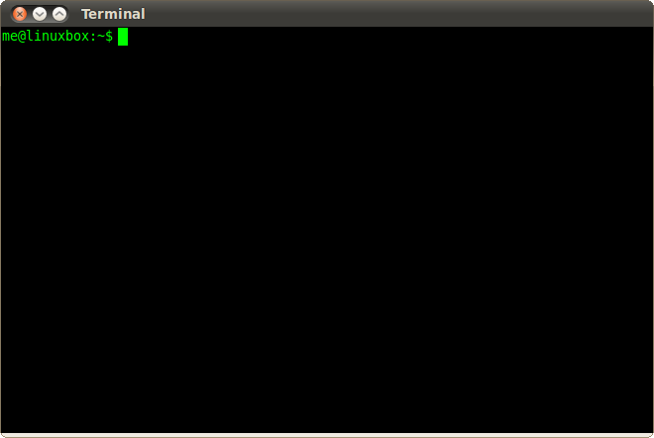
Knowledge in the Head
Stuff you learn and memorize
Takes time to access if not used frequently
Can become automatic with repeated use
Thanks to: http://linuxcommand.org/images/Screenshot-Terminal.png

Slide 8
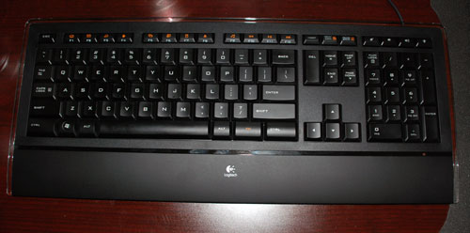
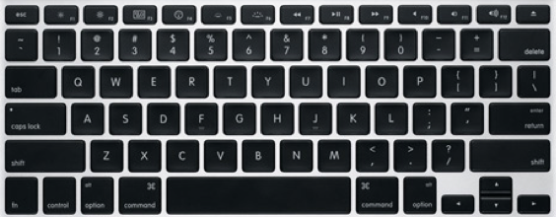
How do you forward-delete?
Knowledge in the World
Knowledge in the Head
Dedicated delete key
May not be obvious the first time
Physical key to remind you afterwards
Cluttered appearance
Command-backspace
Definitely not obvious the first time
Relies on internal memory
Uncluttered appearance
Thanks to: http://arstechnica.com/gadgets/2008/09/quick-take-hands-on-with-the-logitech-illuminated-keyboard/
Thanks to: http://switchtoamac.com/images/hardware/macs/macbookpro/late_2008_mbp_keyboard.png

Slide 9
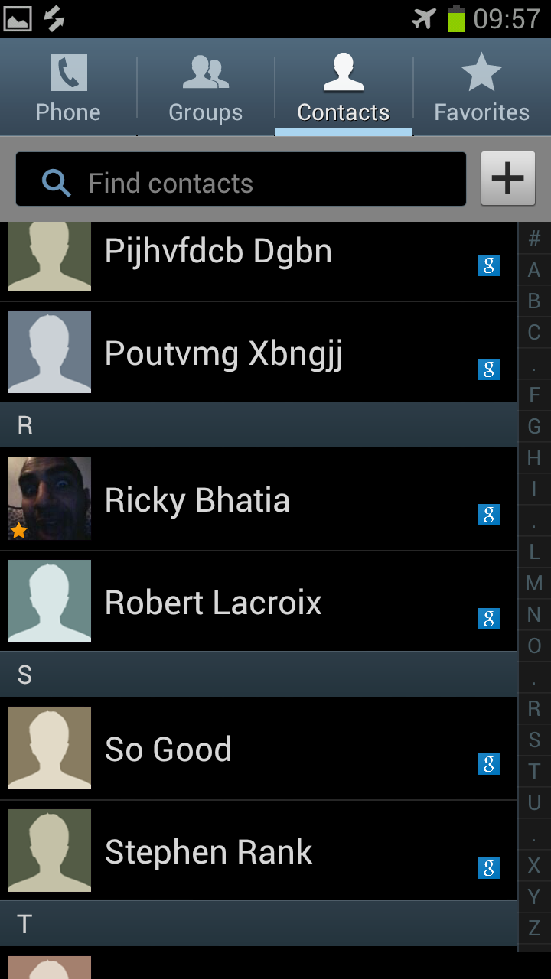
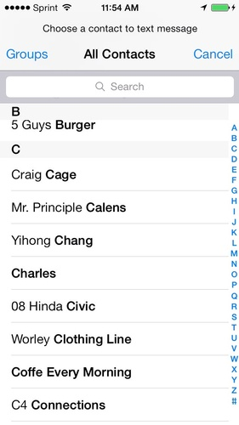
Why Smartphones are Awesome
Quick: how many entries are in your contact list?
How many of those phone numbers/emails/twitter URLs do you know by memory?
Thanks to: http://blog.immersion.com/wp-content/uploads/2012/08/Select-Contact1.png and http://d74bwl3dcueqd.cloudfront.net/images/guide/1e4e8280baae433e8444534282367e1b/281x500_ac.jpg

Slide 10
Why Smartphones are Awesome
Quick: how many entries are in your contact list?
How many of those phone numbers/emails/twitter URLs do you know by memory?
Smart Phones let you move knowledge from your head to the world
Scott Adams calls them "exobrains" http://dilbert.com/blog/entry/dilbert_pocket/
Thanks to: http://blog.immersion.com/wp-content/uploads/2012/08/Select-Contact1.png and http://d74bwl3dcueqd.cloudfront.net/images/guide/1e4e8280baae433e8444534282367e1b/281x500_ac.jpg

Slide 11
Relevance
Anything you expect people to use must have visible controls
Art sites can be beautifully designed and impenetrable
That's why HTML5 and ASP.NET have many standardized controls
Standard libraries make this trivial
See jQueryUI later this week

Slide 12
Typical Manager-Programmer Conversation
Why are you putting a programming language inside a word processor?
Don't "users" want to automate important tasks?
I want to add a feature to display word/page count on the status bar.
You'll clutter up the screen. Don't "users" want things to be as simple as possible?
Okay, but we need a good help system.
Uh, sure. What should we put in it?
Help. For the "users".
Great. Thanks.

Slide 13
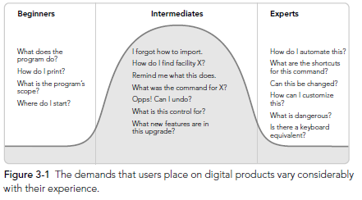
Categories of Users and What They Want to Know
Thanks to: About Face 3

Slide 14
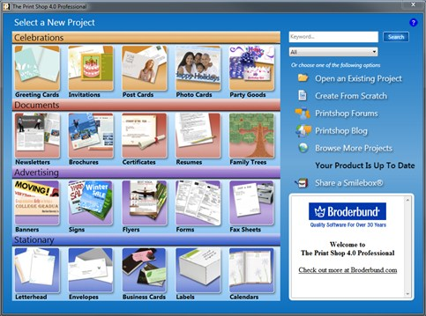
Beginners
"How do I make this do anything?"
Microsoft is really careful about how their programs treat beginners
Microsoft makes lots of money
Facts #1 and #2 are related!
Learnability is much more important than efficiency
Wizards
Large, easy-to-understand controls
Limit scope to make operation easier
Thanks to: http://printshop.com/user-guide/40/getting-started/navigating-the-print-shop.aspx

Slide 15
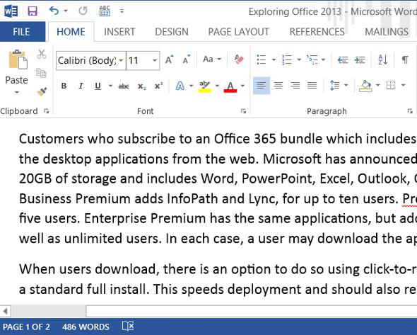
Intermediates
They know somewhat how to use the program, but aren't terribly fluent
Textbook: "user is smart but distracted"
Hints and tips for how things work are helpful at this point
Microsoft actually designs for "perpetual intermediates"
Need a balance between learnability and efficiency
Thanks to: http://cdn.ttgtmedia.com/rms/computerweekly/word-2013.jpg

Slide 16
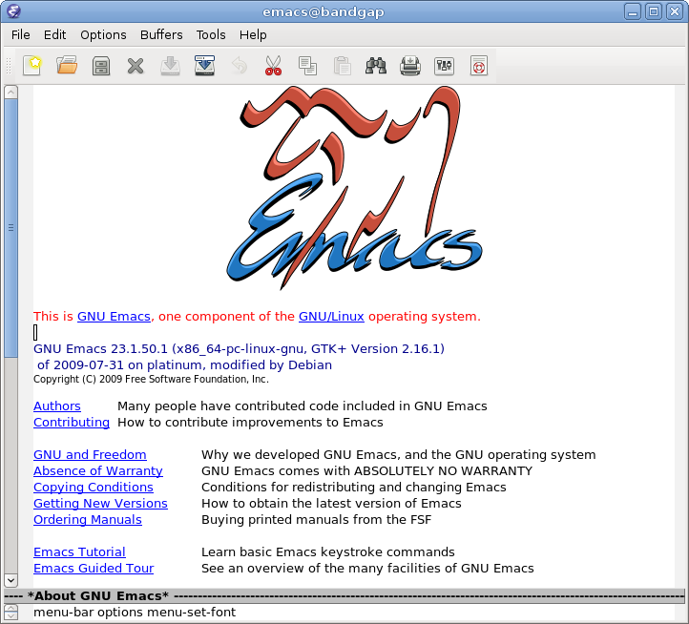
Experts
Know lots about how a program works
May make it do things the original programmer never intended
These are the users that post to message boards, especially about feature requests
Use the program for hours every day
Efficiency is more important than learnability
Thanks to: http://www.gnu.org/software/emacs/tour/images/splash.png

Slide 17
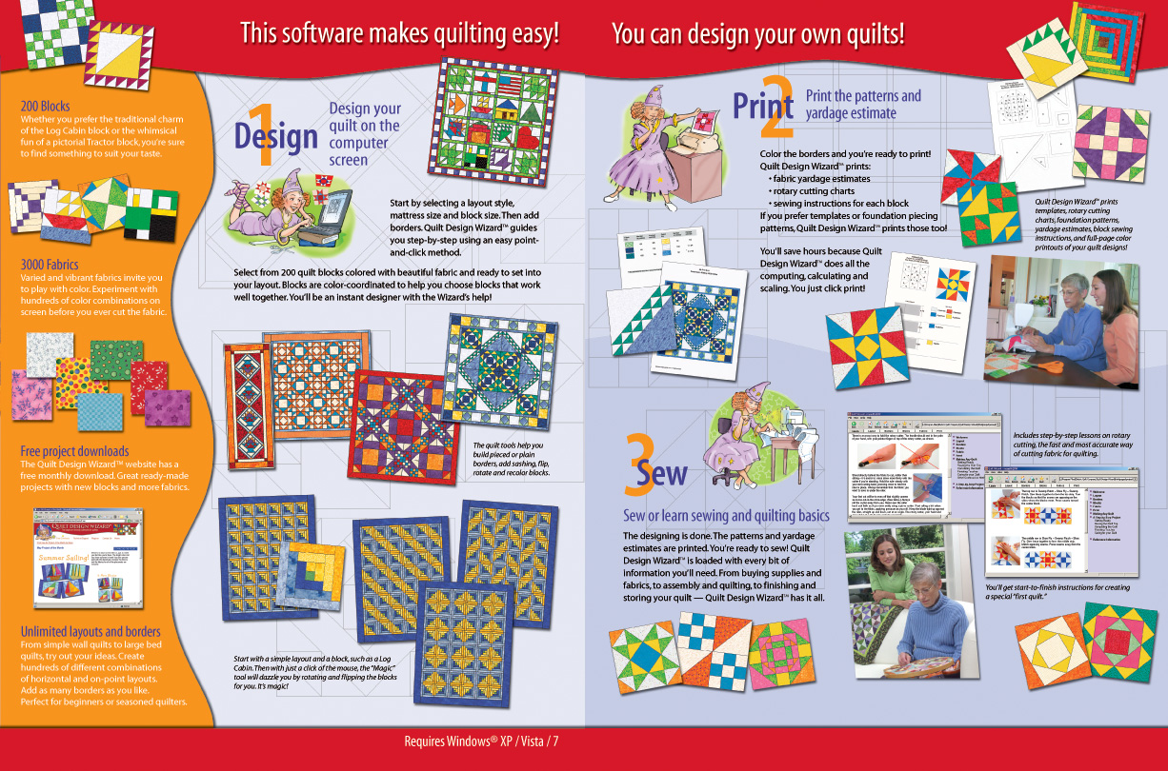
Who is the Target Audience?
Thanks to: http://electricquilt.com/online-shop/quilt-design-wizard/

Slide 18
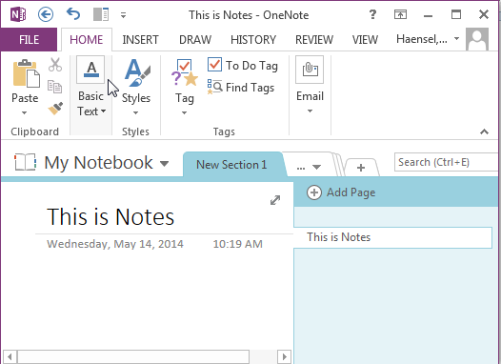
Who is the Target Audience?

Slide 19
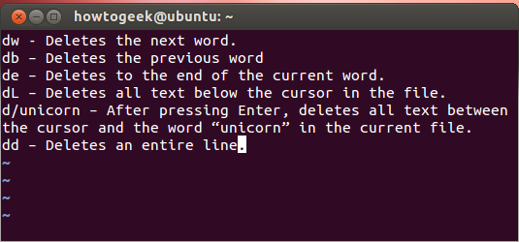
Who is the Target Audience?
Thanks to: http://www.howtogeek.com/115051/become-a-vi-master-by-learning-these-30-key-bindings/

Slide 20
Personality Types
Computer people are almost all NTs
But 75% of the population is S-type
NF: Idealists 15% of the population | NT: Rationalists 10% of the population
SJ: Guardians 45% of the population | SP: Artisans 30% of the population
Thanks to: http://theinnovationeffect.com/personality-tests-graduates-can-use-to-help-with-their-career-search/

Slide 21
Personality Types From an NT perspective, and painting with a broad brush
N-Type ("Intuitive")
S-Type ("Sensor")
Look for patterns
Expect meaning and consistency
Believe things happen for a reason, and are willing to consider those reasons
25% of the population
"Intuitive" user interface = iNtuition
Ignore patterns when they exist
Expect visual flair and differentiation
Don't care about reasons, don't want to know them, just want it to work
. . . for their definition of "work"
75% of the population
Thanks to: http://theinnovationeffect.com/personality-tests-graduates-can-use-to-help-with-their-career-search/

Slide 22
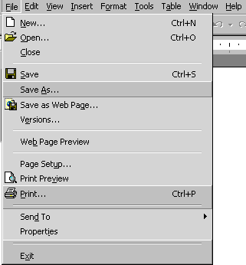
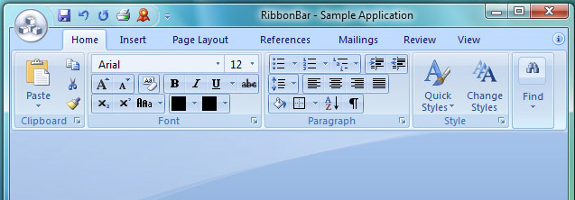
Personality Types and Microsoft Office
N-Type ("Intuitive"): Menus
Lists of things grouped (roughly) in logical order
Full access to all program features
Lots of hidden features: dialogs, etc.
S-Type ("Sensor"): Ribbon
Things grouped in suggestive categories, but somewhat arbitrary ("Home"?)
Program features scattered: is it in a tab, a button, the title bar, a dialog box?
Lots and lots of visible buttons
Thanks to: http://www.gcflearnfree.org/office2000basics/3.4
Thanks to: http://www.prof-uis.com/prof-uis/feature-tour/tour_ribbon_bar_themes.aspx

Slide 23
Personality Types and Microsoft Office
N-Type ("Intuitive"): Menus
25% of the population
Computer savvy
Complain on computer forums
S-Type ("Sensor"): Ribbon
75% of the population
Focused on things other than computers, usually "people", which means ...
Direct the flow of lots of money
Thanks to: http://www.gcflearnfree.org/office2000basics/3.4
Thanks to: http://www.prof-uis.com/prof-uis/feature-tour/tour_ribbon_bar_themes.aspx

Slide 24
Takeaways
Users fit into distinct categories
Know your target audience
A mix is okay, but specify
Not necessarily: make sure your program works for all groups of users
Listen to your experts, but remember they are noisier than other groups
Computer/tech people tend to see the world differently than the general public

